Slide 1

Deep Neural Network Module # 6: CNN
DNN Team
BITS Pilani WILP

Slide 2
The instructor is gratefully acknowledging the authors who made their course materials freely available online.
This deck is prepared by Seetha Parameswaran.
Deep Neural Network

Slide 3










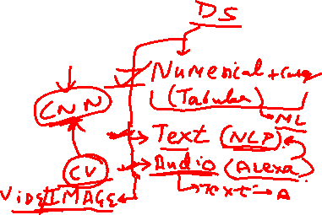
Table of Contents
Computer Vision Tasks
Image Basics and Image Classification Challenges
Introduction to Convolutional Networks
CNN Components
CNN Architecture Design
Popular CNN Architectures
Transfer Learning
CNN Applications
Implementation Considerations
Summary
1
2
3
4
5
6
7
8
9
10
Deep Neural Network

Slide 4
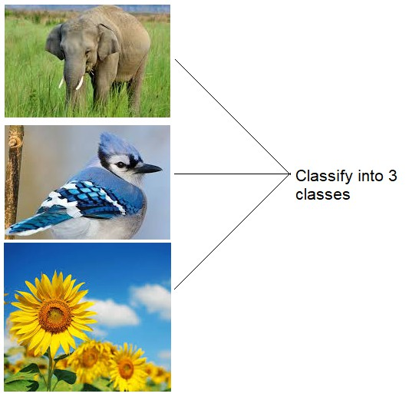
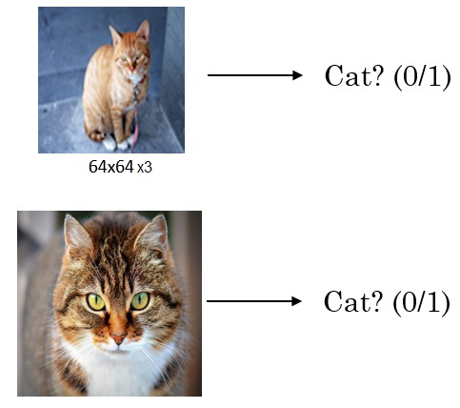
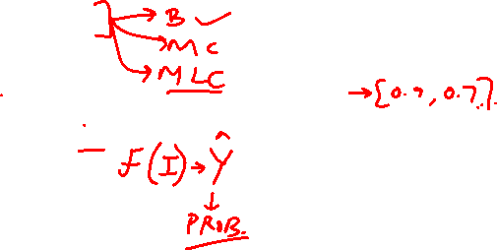
Image Classification
Deep Neural Network

Slide 5
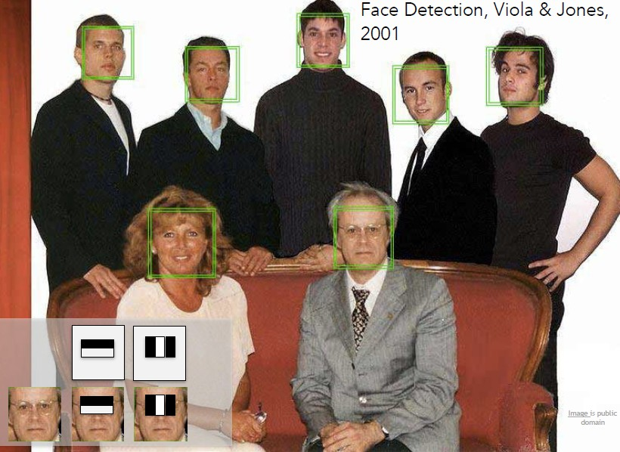
Face Detection
Fei-Fei Li & Justin Johnson & Serena Yeung
Deep Neural Network

Slide 6
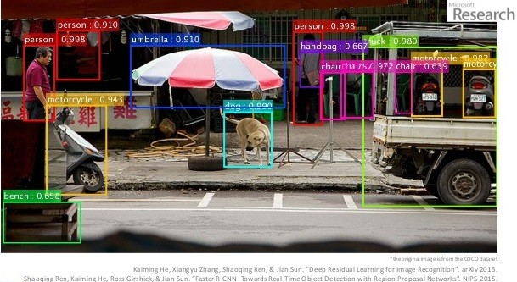
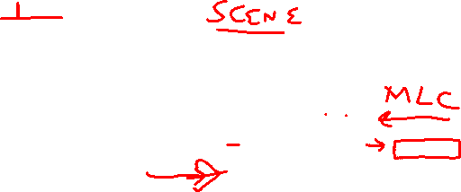
Object Recognition
Derin-Renme-Nedir-Akademik-Biliim-2016
Deep Neural Network

Slide 7
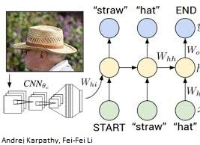
Image Captioning
Deep Neural Network

Slide 8


Table of Contents
Computer Vision Tasks
Image Basics and Image Classification Challenges
Introduction to Convolutional Networks
CNN Components
CNN Architecture Design
Popular CNN Architectures
Transfer Learning
CNN Applications
Implementation Considerations
Summary
1
2
3
4
5
6
7
8
9
10
Deep Neural Network

Slide 9
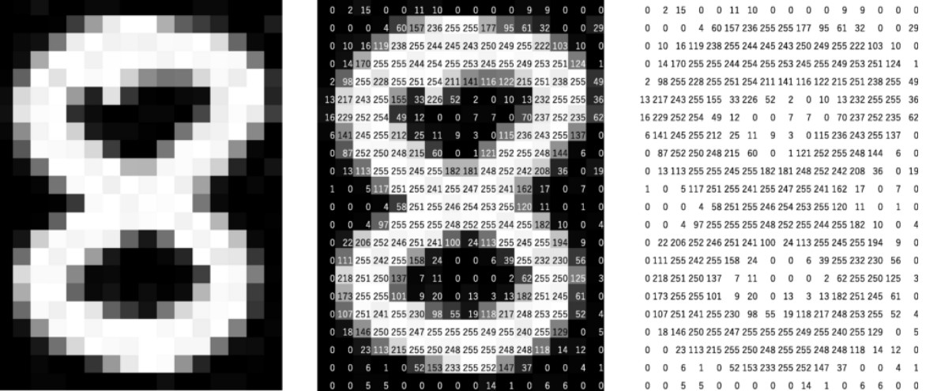

Digital Grayscale Image
Pixel intensities = I(x , y )
https://mozanunal.com/2019/11/img2sh/
Deep Neural Network

Slide 10
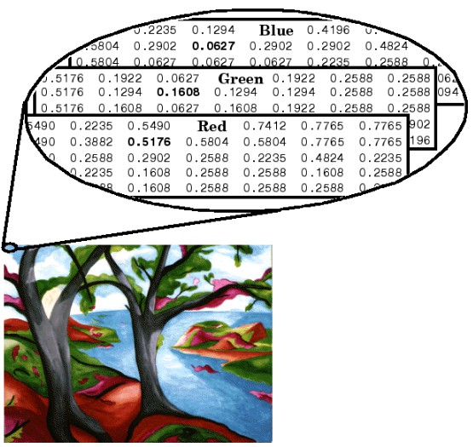
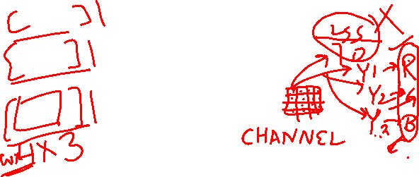
Digital Color Image
https://www.mathworks.com/help/matlab/creating_plots/image-types.html
Deep Neural Network

Slide 11
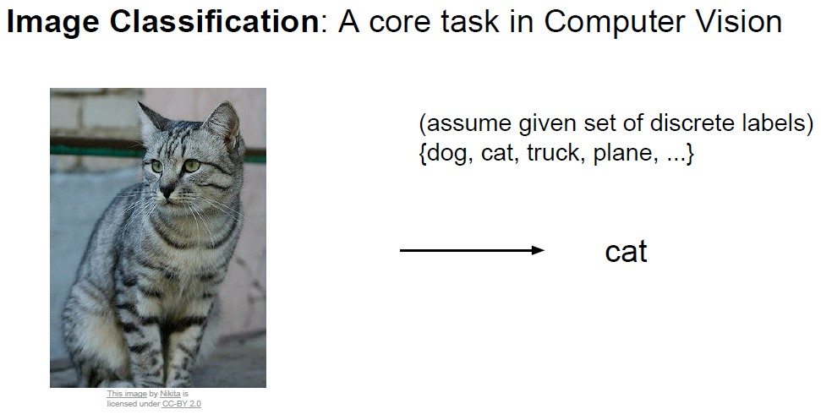
Image Classification - Challenges
Fei-Fei Li & Justin Johnson & Serena Yeung
Deep Neural Network

Slide 12
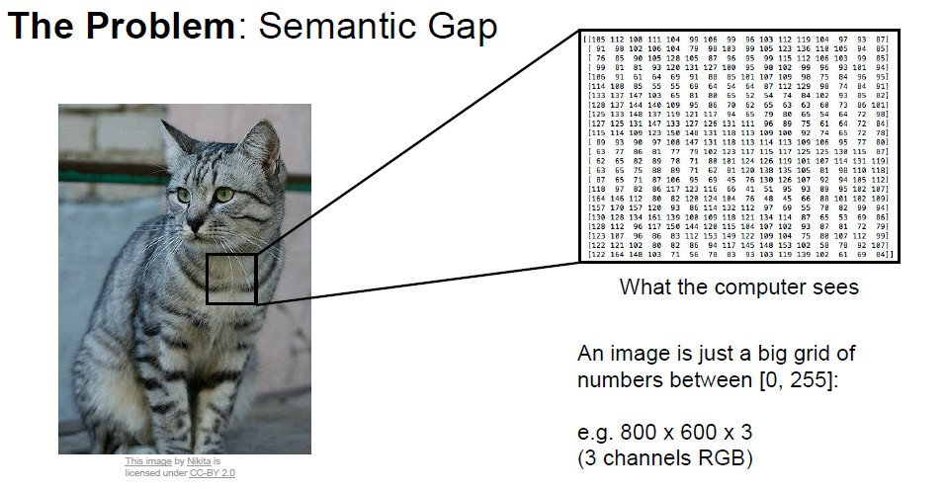
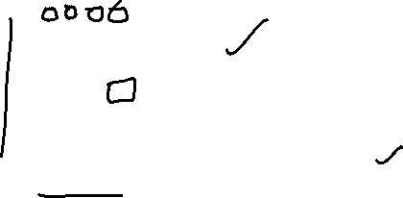
Image Classification - Challenges
Fei-Fei Li & Justin Johnson & Serena Yeung
Deep Neural Network

Slide 13
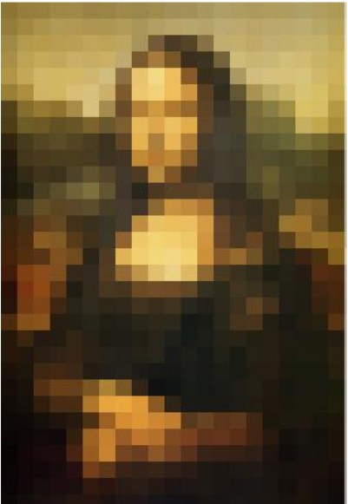
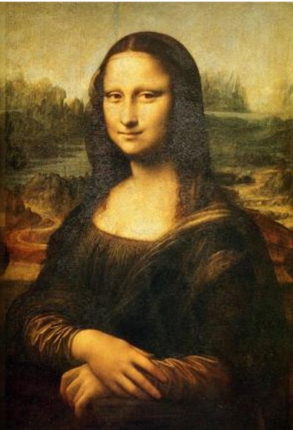
Image Classification - Challenges
Pixelated Images textcolorBitsRedr Images
A 50x50 Image requires 2500 input dimensions.
A HD image 1920x1080 is about 2 million inputs. (2 Mega Pixels)
Deep Neural Network

Slide 14
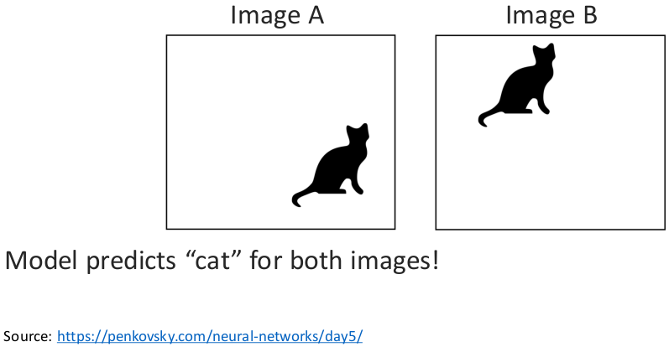
Image Invariance - Challenges
Object can appear anywhere in the image.
Deep Neural Network

Slide 15
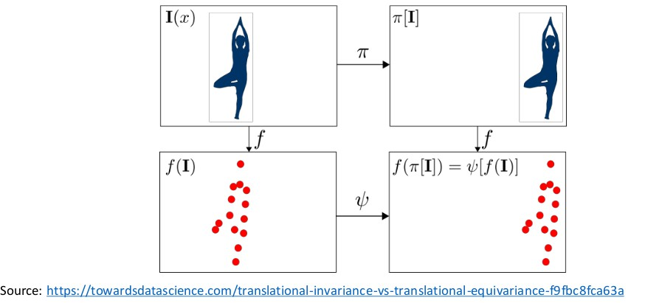
Image Equivariance - Challenges
Changes to the input predictably (equivalently) should not affect the output.
Deep Neural Network

Slide 16
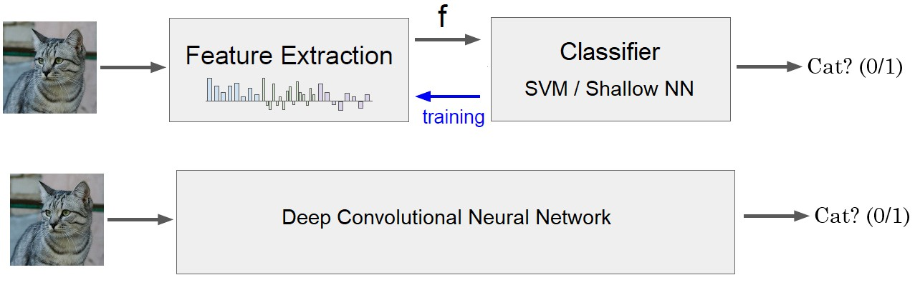
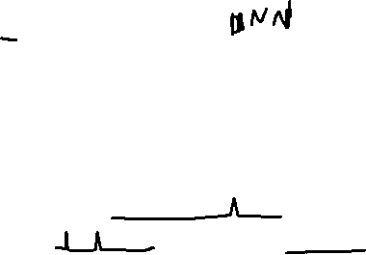
Image Classification - Solution
Deep Neural Network

Slide 17

Table of Contents
Computer Vision Tasks
Image Basics and Image Classification Challenges
Introduction to Convolutional Networks
CNN Components
CNN Architecture Design
Popular CNN Architectures
Transfer Learning
CNN Applications
Implementation Considerations
Summary
1
2
3
4
5
6
7
8
9
10
Deep Neural Network

Slide 18
What is a Convolutional Neural Network?
Definition
A Convolutional Neural Network (CNN) is a specialized type of deep neural network designed to process data with a grid-like topology, such as images, where spatial relationships between data points are important.
Core Insight
CNNs mimic the visual cortex by detecting simple patterns (edges, corners) in early layers and combining them into complex objects (faces, cars) in deeper layers.
Deep Neural Network

Slide 19
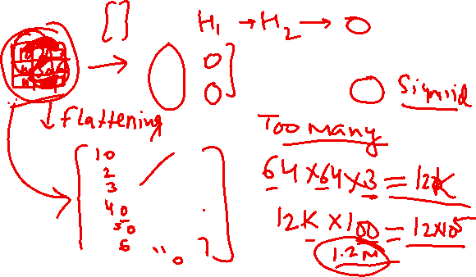

Slide 20
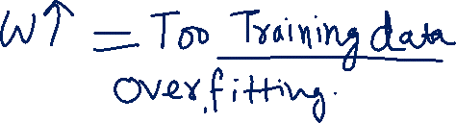

Slide 23

Why Convolutional Networks?
Why CNNs for Images?
Translation Invariance: Object recognition regardless of position
Local Patterns: Detect edges, textures, and shapes locally
Hierarchical Features: Low-level → Mid-level → High-level features
Parameter Efficiency: Fewer parameters than fully connected networks Computational Efficiency: Parallel processing of convolutions
Deep Neural Network

Slide 24
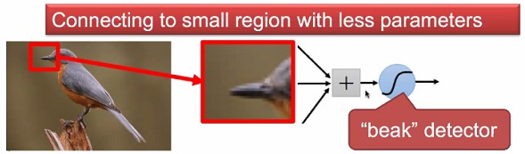

Why CNN for Images - Locality
Some patterns are much smaller than the whole image.
Courtesy: Akka Zemmari
Deep Neural Network

Slide 25
Why CNN for Images - Locality
Some patterns are much smaller than the whole image.
A neuron does not have to see the whole image to discover the pattern.
Courtesy: Akka Zemmari
Deep Neural Network

Slide 26
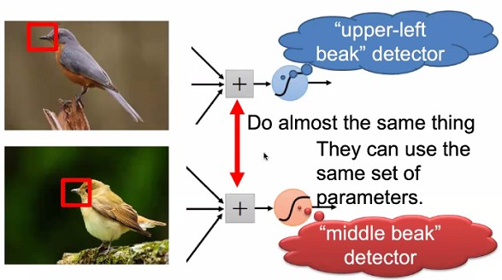
Why CNN for Images - Translation Invariance
Same pattern may appear in different regions.
Courtesy: Akka Zemmari
Deep Neural Network

Slide 27
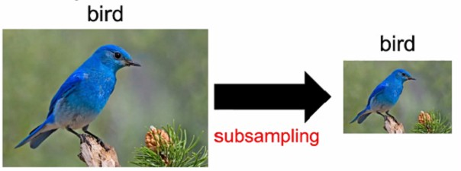

Why CNN for Images - Scale Invariance
Sub-sampling the pixels will not change the object.
We can sub-sample the image to make it smaller.
Less parameters for the network to process the image.
Courtesy: Akka Zemmari
Deep Neural Network

Slide 28
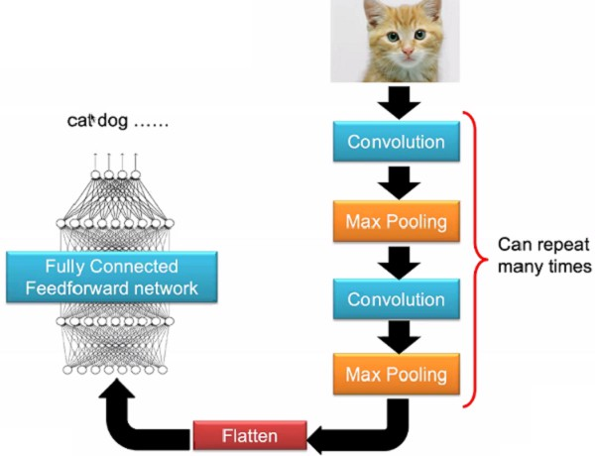
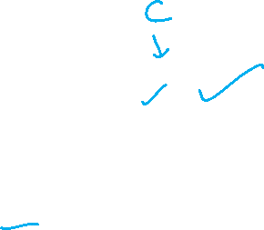
The Whole CNN
Courtesy: Akka Zemmari
Deep Neural Network

Slide 29
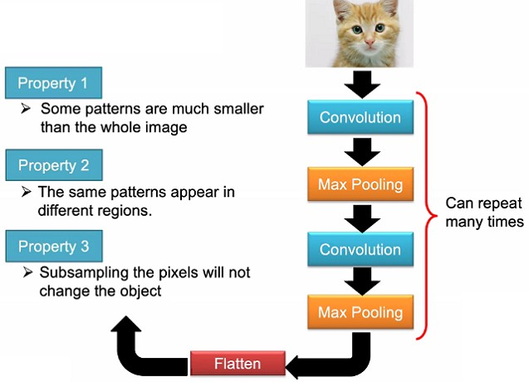
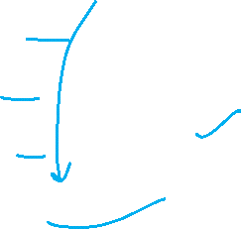
The Whole CNN
Courtesy: Akka Zemmari
Deep Neural Network

Slide 30
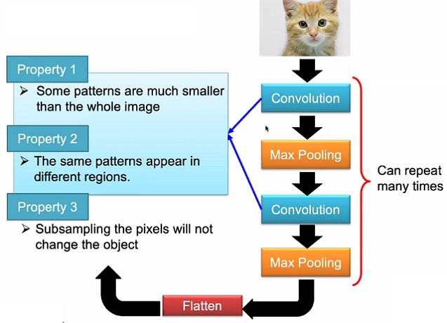
The Whole CNN
Courtesy: Akka Zemmari
Deep Neural Network

Slide 31
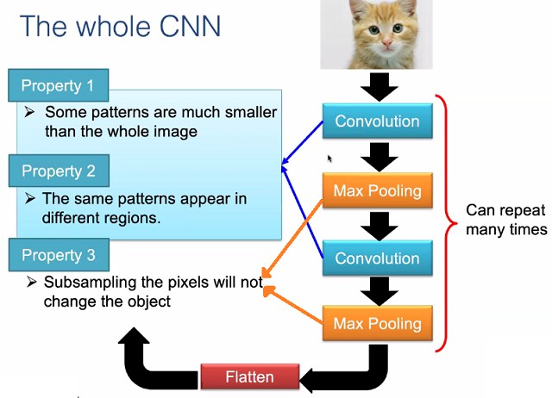

The Whole CNN
Courtesy: Akka Zemmari
Deep Neural Network

Slide 32
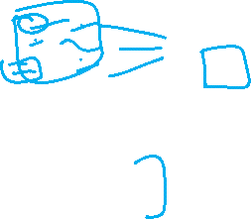
Key Principles of CNNs
Three Key Principles
Local Connectivity (Sparse Interactions)
Each neuron connects only to a local region of the input
Receptive field concept
Parameter Sharing
Same filter/kernel used across entire input
Dramatically reduces parameters
Equivariant Representations
If input shifts, output shifts correspondingly
Built-in translation equivariance
1
2
3
Deep Neural Network

Slide 33
CNN Key Characteristics
Convolutional Layers: Apply learnable filters to detect local features
Pooling Layers: Reduce spatial dimensions and provide translation invariance Hierarchical Learning: Build complex features from simple ones
Parameter Sharing: Same filter applied across entire input Sparse Connectivity: Each neuron connects to local region only
Deep Neural Network

Slide 34
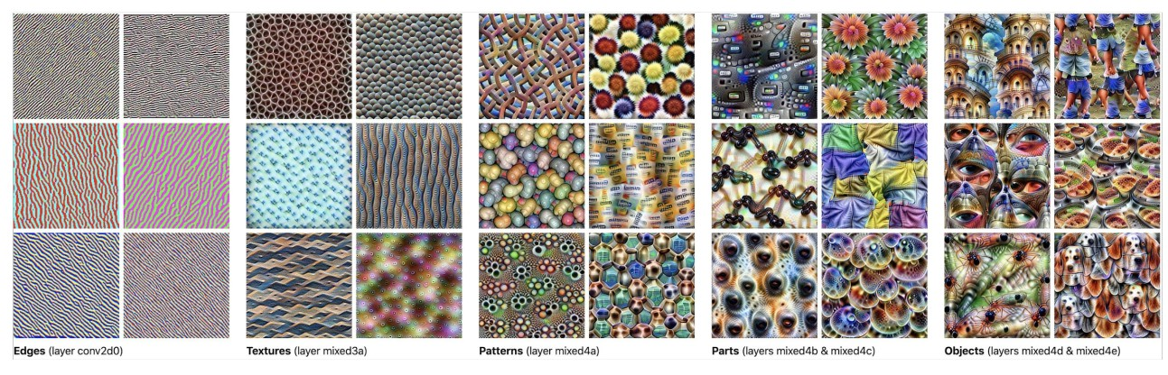
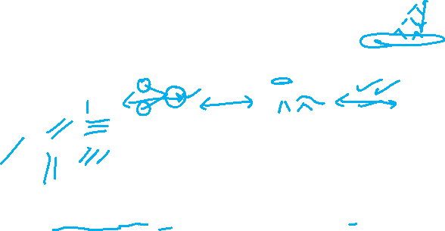
How CNN Achieves Image Classification
Hierarchical Feature Learning Process
CNNs achieve image classification through a hierarchical feature extraction process, where each layer builds increasingly complex representations from simpler ones.
Deep Neural Network

Slide 35

Hierarchical Feature Learning
Deep networks learn increasingly complex features:
Edges Corners Colors
Layer 1 |  | Layer 2 | Textures | Layer 3
 |  |  | Patterns Parts
Objects
Faces Scenes
Low-level features
Mid-level features
High-level features
Example: Face Detection
Layer 1: Detects edges at various orientations
Layer 2: Combines edges into facial features (eyes, nose, mouth) Layer 3: Combines features into complete face
Deep Neural Network

Slide 36
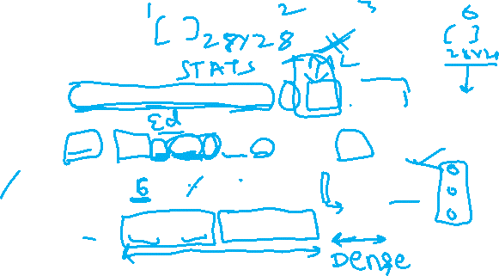
CNN Architecture
Architecture Pattern
INPUT → [CONV → ACTIVATION → POOL] x N → FC → OUTPUT
32×32×3
28×28×6
14×14×6
10×10×16
5×5×16
120
10
Input
Conv1
Pool1
Conv2
Pool2
FC
Output
Deep Neural Network

Slide 37

CNN - Layer-by-Layer Breakdown
Early Layers (1-2)
Purpose: Detect low-level features Features: Edges, corners, lines Filters: Small (3×3, 5×5)
Receptive Field: Local, small regions
Middle Layers (3-4)
Purpose: Combine low-level features Features: Shapes, textures, patterns Complexity: Medium-level abstractions Receptive Field: textcolorBitsRedr regions
Deep Neural Network

Slide 38

CNN - Layer-by-Layer Breakdown
Deep Layers (5+)
Purpose: Detect object parts Features: Wheels, faces, eyes, ears Complexity: High-level semantics
Receptive Field: textcolorBitsRed image regions
Fully Connected Layers
Purpose: Final classification decision Input: Feature vector from conv layers Output: Class probability scores
Function: Combine all learned features
Deep Neural Network

Slide 39
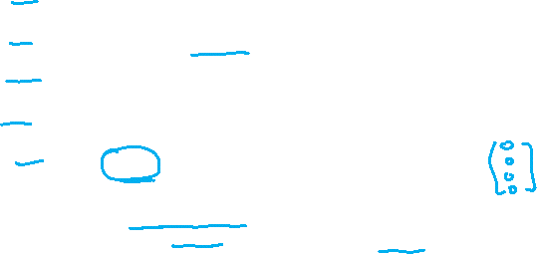
The Classification Process
1
Feature Extraction: Convolutional layers progressively extract features of increasing complexity
Spatial Reduction: Pooling layers reduce spatial dimensions while preserving important information
Feature Combination: Deeper layers combine simpler features to recognize complex patterns
Decision Making: Fully connected layers use extracted features to make final classification decision
Output: Softmax layer produces probability distribution over classes
2
3
4
5
Key Insight
Each layer acts as a feature detector that becomes increasingly sophisticated. Early layers detect simple patterns, while later layers detect complex objects by combining simpler patterns.
Deep Neural Network
35 / 153

Slide 40

Table of Contents
Computer Vision Tasks
Image Basics and Image Classification Challenges
Introduction to Convolutional Networks
CNN Components
CNN Architecture Design
Popular CNN Architectures
Transfer Learning
CNN Applications
Implementation Considerations
Summary
1
2
3
4
5
6
7
8
9
10
Deep Neural Network

Slide 41
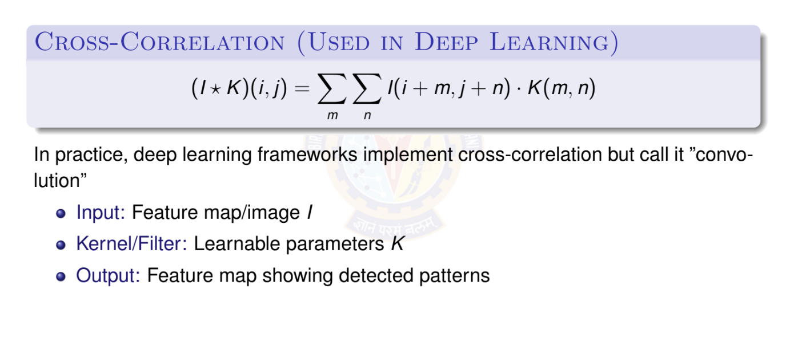
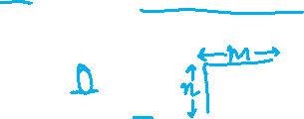
2D Convolution Operation
Deep Neural Network

Slide 42
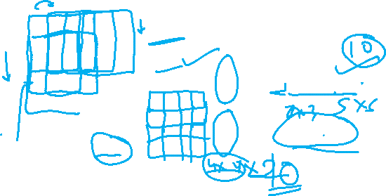
2D Convolution Operation
1 | 0 | 0 | 0 | 0 | 1
0 | 1 | 0 | 0 | 1 | 0
0 | 0 | 1 | 1 | 0 | 0
1 | 0 | 0 | 0 | 1 | 0
0 | 1 | 0 | 0 | 1 | 0
0 | 0 | 1 | 0 | 1 | 0
These values inside the matrix are to be learned by the network. We call these as parameters or weights.
Kernel / Filter 1
1 | -1 | -1
-1 | 1 | -1
-1 | -1 | 1
-1 | 1 | -1
-1 | 1 | -1
-1 | 1 | -1
Kernel / Filter 2
Input Image 6 × 6
Property 1: Each filter detects a small pattern (3 × 3)
Deep Neural Network

Slide 43

Convolution Operation
1 | 0 | 0 | 0 | 0 | 1
0 | 1 | 0 | 0 | 1 | 0
0 | 0 | 1 | 1 | 0 | 0
1 | 0 | 0 | 0 | 1 | 0
0 | 1 | 0 | 0 | 1 | 0
0 | 0 | 1 | 0 | 1 | 0
Start at top left corner. Perform element wise product and add all the values.
1 | -1 | -1
-1 | 1 | -1
-1 | -1 | 1
Filter 1
Output
3
Input Image 6 × 6
Deep Neural Network
39 / 153

Slide 44

Convolution Operation
1 | 0 | 0 | 0 | 0 | 1
0 | 1 | 0 | 0 | 1 | 0
0 | 0 | 1 | 1 | 0 | 0
1 | 0 | 0 | 0 | 1 | 0
0 | 1 | 0 | 0 | 1 | 0
0 | 0 | 1 | 0 | 1 | 0
Slide by one pixel towards right.
Perform element wise product and add all the values.
Filter 1
1 | -1 | -1
-1 | 1 | -1
-1 | -1 | 1
Output
3 -1
Input Image 6 × 6
Deep Neural Network

Slide 45
Convolution Operation
stride s = 1
Slide by one pixel towards right.
Perform element wise product and add all the values.
Filter 1
Output
3 -1 -3
1 | 0 | 0 | 0 | 0 | 1
0 | 1 | 0 | 0 | 1 | 0
0 | 0 | 1 | 1 | 0 | 0
1 | 0 | 0 | 0 | 1 | 0
0 | 1 | 0 | 0 | 1 | 0
0 | 0 | 1 | 0 | 1 | 0
1 | -1 | -1
-1 | 1 | -1
-1 | -1 | 1
Input Image 6 × 6
Deep Neural Network

Slide 46
Convolution Operation
stride s = 1
Slide by one pixel towards right.
Perform element wise product and add all the values.
Filter 1
Output
3 -1 -3 -1
1 | 0 | 0 | 0 | 0 | 1
0 | 1 | 0 | 0 | 1 | 0
0 | 0 | 1 | 1 | 0 | 0
1 | 0 | 0 | 0 | 1 | 0
0 | 1 | 0 | 0 | 1 | 0
0 | 0 | 1 | 0 | 1 | 0
1 | -1 | -1
-1 | 1 | -1
-1 | -1 | 1
Input Image 6 × 6
Deep Neural Network

Slide 47
Convolution Operation
stride s = 1
Jump to next row, left most pixel.
The filter has to completely superimpose the pixels of input.
NOT PARTIALLY.
1 | 0 | 0 | 0 | 0 | 1
0 | 1 | 0 | 0 | 1 | 0
0 | 0 | 1 | 1 | 0 | 0
1 | 0 | 0 | 0 | 1 | 0
0 | 1 | 0 | 0 | 1 | 0
0 | 0 | 1 | 0 | 1 | 0
1 | -1 | -1
-1 | 1 | -1
-1 | -1 | 1
Filter 1
Output
3 -1 -3 -1
Input Image 6 × 6
-3
Deep Neural Network

Slide 48

Convolution Operation
stride s = 1
After sliding through the entire image.
3 -1 -3 -1
-3 -1 0 -3
-3 -2 0 1
3 -2 -2 -1
Output Feature Map
1 | 0 | 0 | 0 | 0 | 1
0 | 1 | 0 | 0 | 1 | 0
0 | 0 | 1 | 1 | 0 | 0
1 | 0 | 0 | 0 | 1 | 0
0 | 1 | 0 | 0 | 1 | 0
0 | 0 | 1 | 0 | 1 | 0
1 | -1 | -1
-1 | 1 | -1
-1 | -1 | 1
Filter 1
Input Image 6 × 6
Deep Neural Network

Slide 49
Convolution Operation
stride s = 1
3 -1 -3 -1
1 | 0 | 0 | 0 | 0 | 1
0 | 1 | 0 | 0 | 1 | 0
0 | 0 | 1 | 1 | 0 | 0
1 | 0 | 0 | 0 | 1 | 0
0 | 1 | 0 | 0 | 1 | 0
0 | 0 | 1 | 0 | 1 | 0
-3 -1 0 -3
-3 -2 0 1
1 | -1 | -1
-1 | 1 | -1
-1 | -1 | 1
3 -2 -2 - 1
Output Feature Map
Filter 1
Input Image 6 × 6
Property 2 is satisfied.
Deep Neural Network

Slide 50
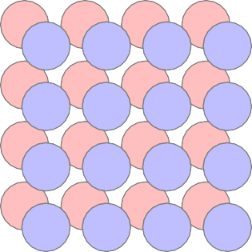
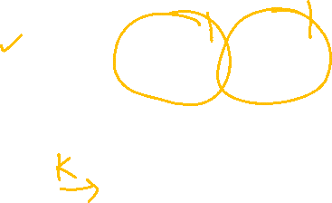
Convolution Operation
Filter 1
Filter 2
stride s = 1
1 | -1 | -1 | -1 | 1 | -1
-1 | 1 | -1 | -1 | 1 | -1
-1 | -1 | 1 | -1 | 1 | -1
1 | 0 | 0 | 0 | 0 | 1
0 | 1 | 0 | 0 | 1 | 0
0 | 0 | 1 | 1 | 0 | 0
1 | 0 | 0 | 0 | 1 | 0
0 | 1 | 0 | 0 | 1 | 0
0 | 0 | 1 | 0 | 1 | 0
3 -1 | -1 -1 | -3 -1 | -1 -1
-3 -1 | -1 -1 | 0 -2 | -3 -1 | Feature
-3 -1 | -2 -1 | 0 -2 | 1 1 | Maps
3 -1 | -2 0 | -2 -4 | -1 3
Input Image 6 × 6
Deep Neural Network

Slide 51
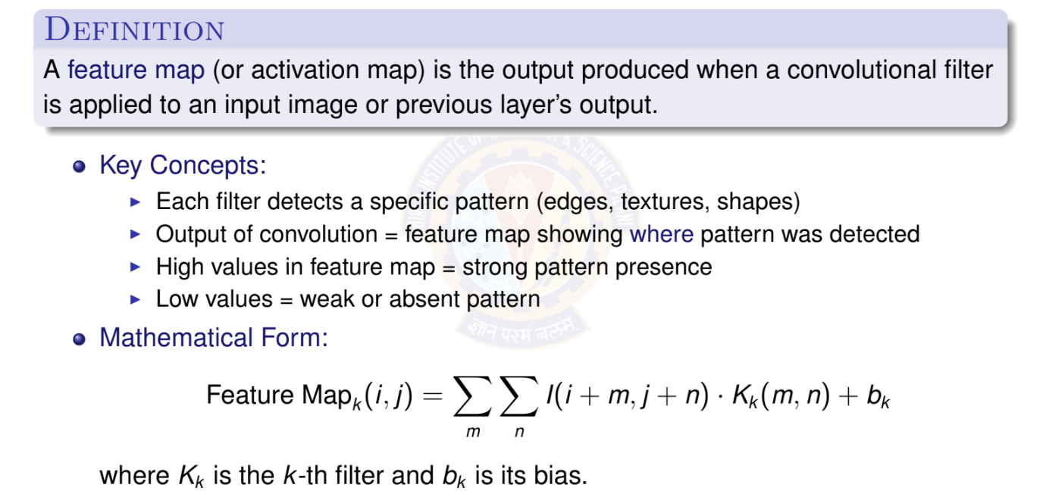

What is a Feature Map?
Deep Neural Network

Slide 52
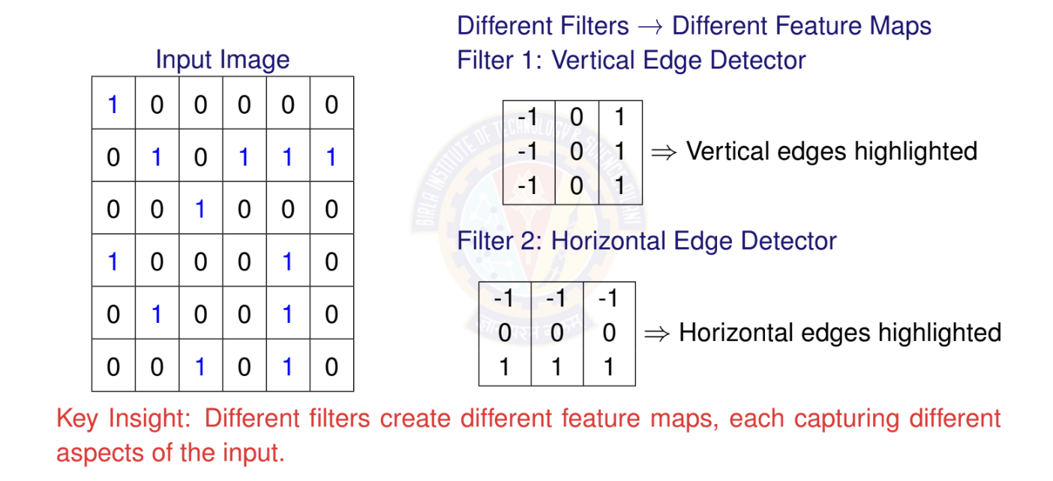

Feature Maps: Visual Example
Deep Neural Network

Slide 53
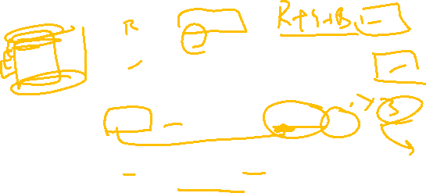
Multiple Feature Maps in CNNs
Single Convolutional Layer with Multiple Filters:
64 Filters
3 × 3
Input
32 × 32 × 3
64 Feature Maps
30 × 30 × 64
Important:
Number of filters = Number of output feature maps
Each feature map = One filter’s response across entire input Stack of feature maps = 3D volume (height × width × channels)
Deep Neural Network

Slide 54
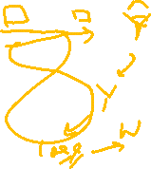
Receptive Field: Definition
Definition
The receptive field of a neuron is the region in the input image that affects that neuron’s activation value.
Key Concepts:
⁾ Receptive field grows with network depth
⁾ Early layers: small receptive fields (local patterns)
⁾ Deep layers: large receptive fields (global context)
⁾ Determined by kernel size, stride, and pooling
Importance:
⁾ Small receptive field: Cannot capture large objects
⁾ Large receptive field: Better context understanding
⁾ Trade-off: Computational cost vs. context
Deep Neural Network

Slide 55

References
Zhang, A., Lipton, Z. C., Li, M., & Smola, A. J. (2023). Dive into deep learning. Cambridge University Press. Chapters 6 and 7.
Goodfellow, I., Bengio, Y., Courville, A. (2016). Deep Learning. MIT Press. LeCun, Y., Bottou, L., Bengio, Y., & Haffner, P. (1998). Gradient-based learning applied to document recognition. Proceedings of the IEEE, 86(11), 2278-2324.
Krizhevsky, A., Sutskever, I., & Hinton, G. E. (2012). ImageNet classification with deep convolutional neural networks. Advances in NIPS.
Simonyan, K., & Zisserman, A. (2014). Very deep convolutional networks for large-scale image recognition. arXiv preprint arXiv:1409.1556.
Szegedy, C., et al. (2015). Going deeper with convolutions. Proceedings of the IEEE CVPR.
He, K., Zhang, X., Ren, S., & Sun, J. (2016). Deep residual learning for image recognition. Proceedings of the IEEE CVPR.
Deep Neural Network

